Slide 1

A PROPOSAL ON MACHINE LEARNING-BASED SOLUTION FOR DETECTING CREDIT CARD FRAUD
DAVID OGBEIDE
SCHOOL OF BUSINESS
ST. LAWRENCE COLLEGE
ADMN5016
APPLIED ARTIFICIAL INTELLIGENCE AND MACHINE LEARNING
SUJOY PAUL

Slide 2

Table of content
Introduction
CarSale Company
Problem Statement/Objectives
Challenges and limitations faced by traditional fraud detection methods
Dataset Description
Key observations from the summary statistics
Value Proposition
Implementation Plan
Model Performance
Monetary Value and Risk of the Application based on its Model Performance
Monetary Value and Risk of the Application based on its Model Performance
Conclusion
Future Considerations and Enhancements
References

Slide 3

Introduction
ClearSale is a company that goes beyond simple credit card fraud detection to generate trust between company and their good customers to improve total results for their businesses.
In 2020, there were well over 2 million fraud reports made to the Federal Trade Commission (FTC), a number that continues to rise as people shift to an even bigger digital presence.
Using artificial intelligence (AI), fraud monitoring programs can sift through large amounts of data in a short time, learning along the way to recognize threats as they emerge.

Slide 4

Objectives
Reduction in False Positives
Real-time Fraud Detection
Cost Savings and Mitigation
Enhanced Fraud Detection Accuracy
This Photo by Unknown Author is licensed under CC BY-SA-NC

Slide 5

Challenges and limitations faced by traditional fraud detection methods
Changing fraud patterns over time
Class Imbalance
Model Interpretations
Feature generation can be time-consuming

Slide 6
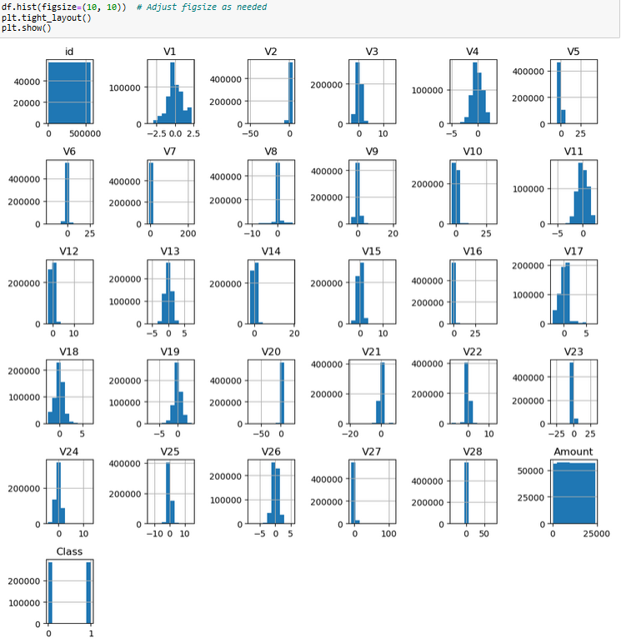
Data
Description
The dataset used for this training and testing machine learning models on credit card fraud detection comprises 284,807 rows and 31 columns.

Slide 7
Improved Accuracy
Reduced False Positives
Cost Savings
Value Proposition
Real-time Detection

Slide 8

Implementation Plan
Phase 1 - Data Preparation and Preprocessing: Discuss steps to clean, preprocess, and normalize the dataset.
Phase 2 - Model Training and Validation: Detail the model training, validation, and selection process.
Phase 3 - Deployment and Monitoring: Describe how the selected model will be deployed into the system and monitored for performance.
This Photo by Unknown Author is licensed under CC BY-SA

Slide 9
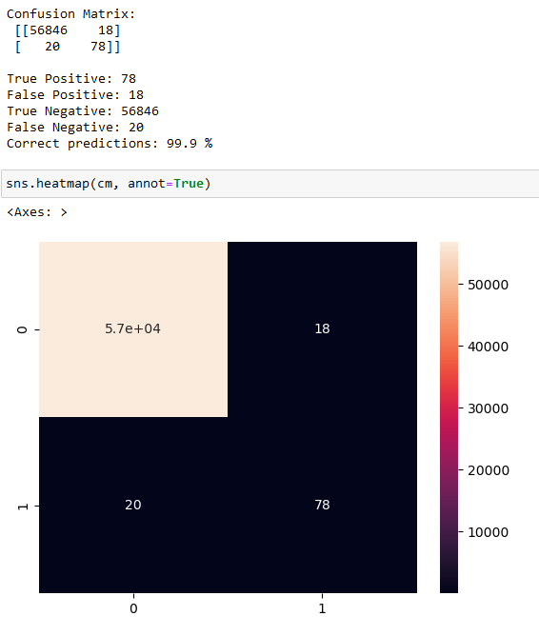
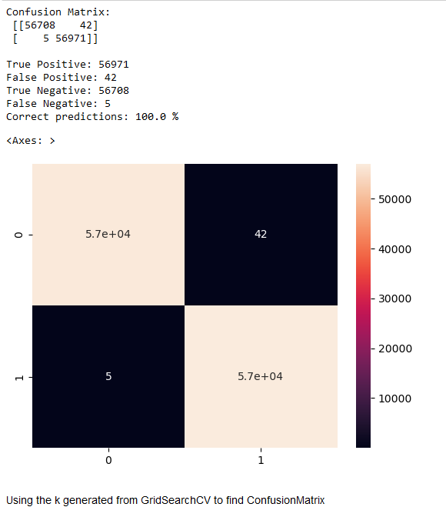
Model Performance
SVM
K-NN

Slide 10

The performance metrics for the KNN (K-Nearest Neighbors) method are as follows:
The confusion matrix indicates an excellent performance by the model. Here's the breakdown:
True Positive (TP): 56971 instances were correctly predicted as positive (e.g., correctly identifying fraudulent transactions).
False Positive (FP): Only 42 instances were incorrectly predicted as positive when they were negative (e.g., incorrectly flagging non-fraudulent transactions as fraudulent).
True Negative (TN): 56708 instances were correctly predicted as negative (e.g., correctly identifying non-fraudulent transactions).
False Negative (FN): There were 5 instances where the model predicted negative when it should have been positive (e.g., failing to identify actual fraudulent transactions).
The performance metrics of the Support Vector Classifier (SVC) model are as follows:
Precision for class 0 (non-fraudulent): 100%
Recall for class 0: 100%
F1-score for class 0: 100%
Support for class 0: 56864
Precision for class 1 (fraudulent): 81%
Recall for class 1: 80%
F1-score for class 1: 80%
Support for class 1: 98
Accuracy: 100%

Slide 11

The proposed solution for credit card fraud detection using machine learning demonstrates considerable effectiveness:
Effectiveness: The models, including KNN, SVC, and others, achieved high accuracy, precision, and recall rates in identifying fraudulent transactions, minimizing both false negatives and false positives. For instance, the SVC model exhibited an accuracy of 99% and a high precision-recall balance.
Advantages: These models effectively reduced financial losses by accurately identifying potentially fraudulent transactions. They showcased a high ability to discern fraudulent cases while maintaining a low false positive rate, crucial for financial systems.
This Photo by Unknown Author is licensed under CC BY-NC-ND

Slide 12

Future Considerations and Enhancement
Real-time Implementation
Ensemble Methods
Imbalanced Data Handling
Feature Engineering
Interpretability
Adaptive Learning
This Photo by Unknown Author is licensed under CC BY-SA

Slide 13
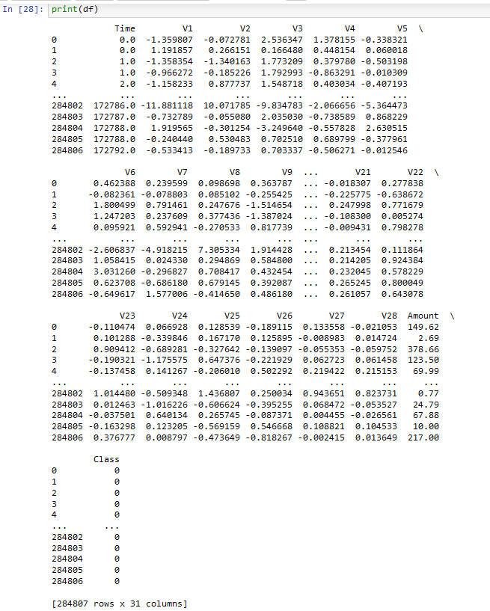
Python Codes and Visualization
df.shape
(568630, 31)
df.hist(figsize=(10, 10)) # Adjust figsize as needed
plt.tight_layout()
plt.show()
print(df['Class'].value_counts())
0 284315
1 284315
Name: Class, dtype: int64

Slide 14
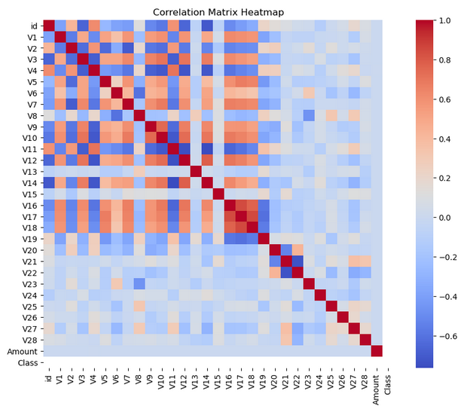
Plotting the heatmap
plt.figure(figsize=(10, 8))
heatmap = sns.heatmap(correlation_matrix, annot=False, cmap='coolwarm', fmt=".2f")
plt.title('Correlation Matrix Heatmap')
plt.show()

Slide 15
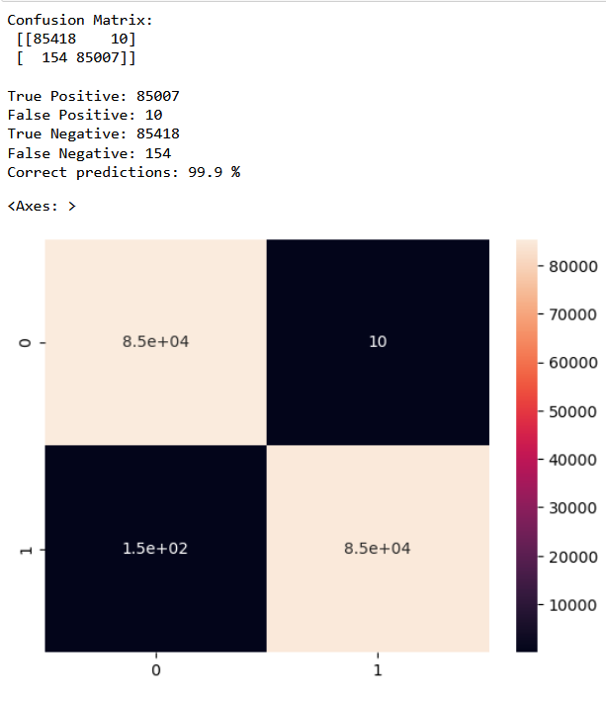
print("Confusion Matrix:\n", cm, "\n")
print("True Positive:",true_positive )
print("False Positive:",false_positive )
print("True Negative:",true_negative )
print("False Negative:",false_negative )
print("Correct predictions:",round((true_positive +
true_negative)/len(y_pred)*100,1),'%' )
#print(cm)
sns.heatmap(cm, annot=True)

Slide 16
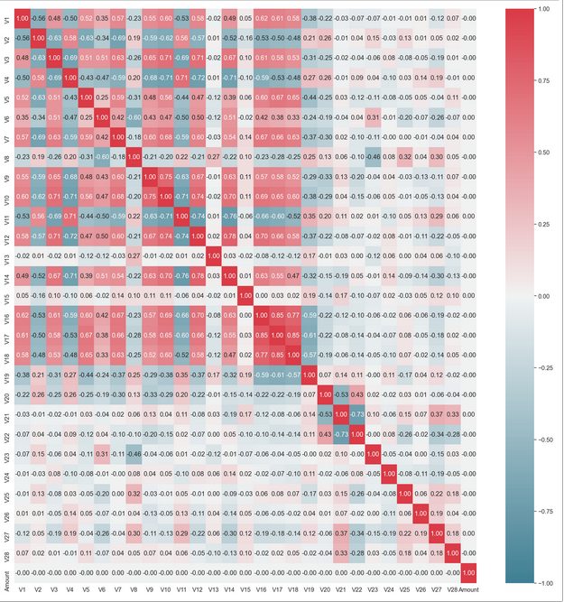
plt.figure(figsize=(25,25))
corr = X.corr()
cmap=sns.diverging_palette(220,10, as_cmap=True)
sns.heatmap(corr, annot=True, cmap=cmap,vmin=-1,vmax=1, center=0,
fmt='.2f')
plt.show()

Slide 17
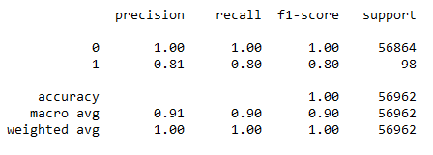

y_pred = svc_model.predict(X_test)
print(classification_report(y_test,y_pred))
This Photo by Unknown Author is licensed under CC BY-SA-NC

Slide 18

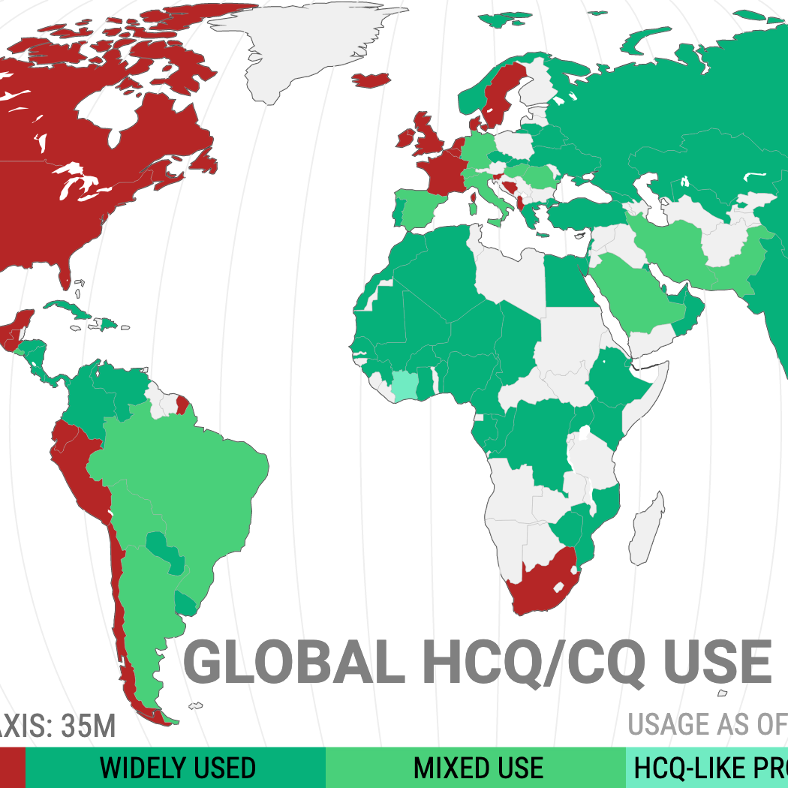
References
https://www.okta.com/identity-101/fraud-monitoring/
https://complyadvantage.com/insights/what-is-fraud-detection/
https://medium.com/razorthink-ai/4-major-challenges-facing-fraud-detection-ways-to-resolve-them-using-machine-learning-cf6ed1b176dd

